Slide 1
PHP
Made by: Eng. Doaa m.Abd elfatah

Slide 2
Global Variables
Superglobals

Slide 3
Superglobals
Several predefined variables in PHP are "superglobals", which means that they are always accessible, regardless of scope - and you can access them from any function, class or file without having to do anything special.
$GLOBALS
$_SERVER
$_REQUEST
$_POST
$_GET
$_FILES
$_ENV
$_COOKIE
$_SESSION

Slide 4
PHP $GLOBALS
$GLOBALS is a PHP super global variable which is used to access global variables from anywhere in the PHP script (also from within functions or methods).
PHP stores all global variables in an array called $GLOBALS[index]. The index holds the name of the variable.

Slide 5
PHP $GLOBALS
<?php $x = 75; $y = 25; function addition() { $GLOBALS['z'] = $GLOBALS['x'] + $GLOBALS['y']; } addition(); echo $z; ?>

Slide 6
PHP $_SERVER
$_SERVER is a PHP super global variable which holds information about headers, paths, and script locations.
<?php echo $_SERVER['PHP_SELF']; echo "<br>"; echo $_SERVER['SERVER_NAME']; echo "<br>"; echo $_SERVER['HTTP_HOST']; echo "<br>"; echo $_SERVER['HTTP_REFERER']; echo "<br>"; echo $_SERVER['HTTP_USER_AGENT']; echo "<br>"; echo $_SERVER['SCRIPT_NAME']; ?>

Slide 7
Element/Code | Description
$_SERVER['PHP_SELF'] | Returns the filename of the currently executing script
$_SERVER['GATEWAY_INTERFACE'] | Returns the version of the Common Gateway Interface (CGI) the server is using
$_SERVER['SERVER_ADDR'] | Returns the IP address of the host server
$_SERVER['SERVER_NAME'] | Returns the name of the host server (such as www.w3schools.com)
$_SERVER['SERVER_SOFTWARE'] | Returns the server identification string (such as Apache/2.2.24)
$_SERVER['SERVER_PROTOCOL'] | Returns the name and revision of the information protocol (such as HTTP/1.1)
$_SERVER['REQUEST_METHOD'] | Returns the request method used to access the page (such as POST)
$_SERVER['REQUEST_TIME'] | Returns the timestamp of the start of the request (such as 1377687496)
$_SERVER['QUERY_STRING'] | Returns the query string if the page is accessed via a query string
$_SERVER['HTTP_ACCEPT'] | Returns the Accept header from the current request
$_SERVER['HTTP_ACCEPT_CHARSET'] | Returns the Accept_Charset header from the current request (such as utf-8,ISO-8859-1)
$_SERVER['HTTP_HOST'] | Returns the Host header from the current request
$_SERVER['HTTP_REFERER'] | Returns the complete URL of the current page (not reliable because not all user-agents support it)
$_SERVER['HTTPS'] | Is the script queried through a secure HTTP protocol
$_SERVER['REMOTE_ADDR'] | Returns the IP address from where the user is viewing the current page
$_SERVER['REMOTE_HOST'] | Returns the Host name from where the user is viewing the current page
$_SERVER['REMOTE_PORT'] | Returns the port being used on the user's machine to communicate with the web server
$_SERVER['SCRIPT_FILENAME'] | Returns the absolute pathname of the currently executing script
$_SERVER['SERVER_ADMIN'] | Returns the value given to the SERVER_ADMIN directive in the web server configuration file (if your script runs on a virtual host, it will be the value defined for that virtual host) (such as someone@w3schools.com)
$_SERVER['SERVER_PORT'] | Returns the port on the server machine being used by the web server for communication (such as 80)
$_SERVER['SERVER_SIGNATURE'] | Returns the server version and virtual host name which are added to server-generated pages
$_SERVER['PATH_TRANSLATED'] | Returns the file system based path to the current script
$_SERVER['SCRIPT_NAME'] | Returns the path of the current script
$_SERVER['SCRIPT_URI'] | Returns the URI of the current page

Slide 8
PHP $_REQUEST
PHP $_REQUEST is used to collect data after submitting an HTML form.
<html> <body> <form method="post" action="<?php echo $_SERVER['PHP_SELF'];?>"> Name: <input type="text" name="fname"> <input type="submit"> </form> <?php $name = $_REQUEST['fname']; echo $name; ?> </body> </html>

Slide 9
PHP $_POST
PHP $_POST is widely used to collect form data after submitting an HTML form with method="post". $_POST is also widely used to pass variables.
<html> <body> <form method="post" action="<?php echo $_SERVER['PHP_SELF'];?>"> Name: <input type="text" name="fname"> <input type="submit"> </form> <?php $name = $_POST['fname']; echo $name; ?> </body> </html>

Slide 10
PHP $_GET
PHP $_GET can also be used to collect form data after submitting an HTML form with method="get".
$_GET can also collect data sent in the URL.

Slide 11
<html> <body> <?php echo "Study " . $_GET['subject'] . " at " . $_GET['web']; ?> </body> </html>
<html> <body> <a href="test_get.php?subject=PHP&web=W3schools.com">Test $GET</a> </body> </html>

Slide 12
Form Handling

Slide 13
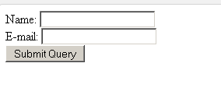
HTML Form

Slide 14
Using post method
<html> <body> <form action="welcome.php" method="post"> Name: <input type="text" name="name"><br> E-mail: <input type="text" name="email"><br> <input type="submit"> </form> </body> </html>

Slide 15
When the user fills out the form above and clicks the submit button, the form data is sent for processing to a PHP file named "welcome.php". The form data is sent with the HTTP POST method.
<html> <body> Welcome <?php echo $_POST["name"]; ?><br> Your email address is: <?php echo $_POST["email"]; ?> </body> </html>

Slide 16
Using get method
<html> <body> <form action="welcome_get.php" method="get"> Name: <input type="text" name="name"><br> E-mail: <input type="text" name="email"><br> <input type="submit"> </form> </body> </html>

Slide 17
<html> <body> Welcome <?php echo $_GET["name"]; ?><br> Your email address is: <?php echo $_GET["email"]; ?> </body> </html>

Slide 18
GET vs. POST
Both GET and POST create an array (e.g. array( key => value, key2 => value2, key3 => value3, ...)). This array holds key/value pairs, where keys are the names of the form controls and values are the input data from the user.
Both GET and POST are treated as $_GET and $_POST. These are superglobals, which means that they are always accessible, regardless of scope - and you can access them from any function, class or file without having to do anything special.
$_GET is an array of variables passed to the current script via the URL parameters.
$_POST is an array of variables passed to the current script via the HTTP POST method.

Slide 19
When to use GET?
Information sent from a form with the GET method is visible to everyone (all variable names and values are displayed in the URL). GET also has limits on the amount of information to send. The limitation is about 2000 characters. However, because the variables are displayed in the URL, it is possible to bookmark the page. This can be useful in some cases.
GET may be used for sending non-sensitive data.
Note: GET should NEVER be used for sending passwords or other sensitive information!

Slide 20
When to use POST?
Information sent from a form with the POST method is invisible to others (all names/values are embedded within the body of the HTTP request) and has no limits on the amount of information to send.
Moreover POST supports advanced functionality such as support for multi-part binary input while uploading files to server.
However, because the variables are not displayed in the URL, it is not possible to bookmark the page.
Developers prefer POST for sending form data.

Slide 21
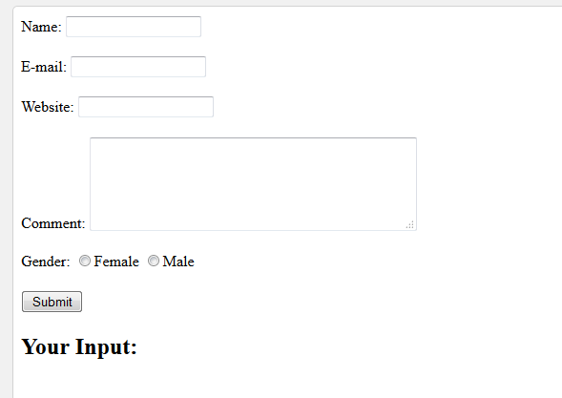

Slide 22
<!DOCTYPE HTML> <html> <head> </head> <body> <?php // define variables and set to empty values $name = $email = $gender = $comment = $website = ""; if ($_SERVER["REQUEST_METHOD"] == "POST") { $name = test_input($_POST["name"]); $email = test_input($_POST["email"]); $website = test_input($_POST["website"]); $comment = test_input($_POST["comment"]); $gender = test_input($_POST["gender"]); } function test_input($data) { $data = trim($data); $data = stripslashes($data); $data = htmlspecialchars($data); return $data; } ?>

Slide 23
<h2>PHP Form Validation Example</h2> <form method="post" action="<?php echo htmlspecialchars($_SERVER["PHP_SELF"]);?>"> Name: <input type="text" name="name"> <br><br> E-mail: <input type="text" name="email"> <br><br> Website: <input type="text" name="website"> <br><br> Comment: <textarea name="comment" rows="5" cols="40"></textarea> <br><br> Gender: <input type="radio" name="gender" value="female">Female <input type="radio" name="gender" value="male">Male <br><br> <input type="submit" name="submit" value="Submit"> </form>

Slide 24
<?php echo "<h2>Your Input:</h2>"; echo $name; echo "<br>"; echo $email; echo "<br>"; echo $website; echo "<br>"; echo $comment; echo "<br>"; echo $gender; ?> </body> </html>

Slide 25
What is the htmlspecialchars() function?
The htmlspecialchars() function converts special characters to HTML entities. This means that it will replace HTML characters like < and > with &lt; and &gt;. This prevents attackers from exploiting the code by injecting HTML or Javascript code (Cross-site Scripting attacks) in forms.

Slide 26
Using Functions
trim
stripslashes
trim — Strip whitespace (or other characters) from the beginning and end of a string.
stripslashes — Un-quotes a quoted string

Slide 27
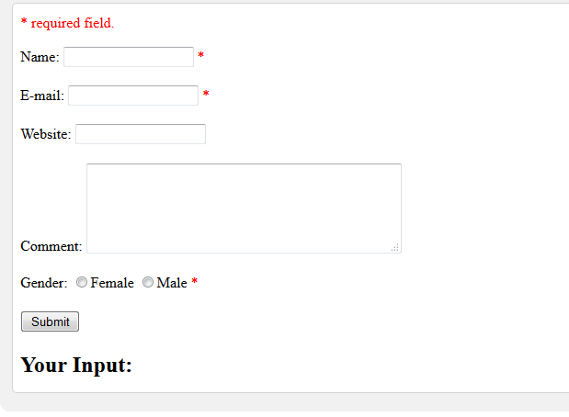

Slide 28
<!DOCTYPE HTML> <html> <head> <style> .error {color: #FF0000;} </style> </head> <body> <?php // define variables and set to empty values $nameErr = $emailErr = $genderErr = $websiteErr = ""; $name = $email = $gender = $comment = $website = ""; if ($_SERVER["REQUEST_METHOD"] == "POST") { if (empty($_POST["name"])) { $nameErr = "Name is required"; } else { $name = test_input($_POST["name"]); } if (empty($_POST["email"])) { $emailErr = "Email is required"; } else { $email = test_input($_POST["email"]); }

Slide 29
if (empty($_POST["website"])) { $website = ""; } else { $website = test_input($_POST["website"]); } if (empty($_POST["comment"])) { $comment = ""; } else { $comment = test_input($_POST["comment"]); } if (empty($_POST["gender"])) { $genderErr = "Gender is required"; } else { $gender = test_input($_POST["gender"]); } } function test_input($data) { $data = trim($data); $data = stripslashes($data); $data = htmlspecialchars($data); return $data; } ?>

Slide 30
<h2>PHP Form Validation Example</h2> <p><span class="error">* required field.</span></p> <form method="post" action="<?php echo htmlspecialchars($_SERVER["PHP_SELF"]);?>"> Name: <input type="text" name="name"> <span class="error">* <?php echo $nameErr;?></span> <br><br> E-mail: <input type="text" name="email"> <span class="error">* <?php echo $emailErr;?></span> <br><br> Website: <input type="text" name="website"> <span class="error"><?php echo $websiteErr;?></span> <br><br> Comment: <textarea name="comment" rows="5" cols="40"></textarea> <br><br> Gender: <input type="radio" name="gender" value="female">Female <input type="radio" name="gender" value="male">Male <span class="error">* <?php echo $genderErr;?></span> <br><br> <input type="submit" name="submit" value="Submit"> </form>

Slide 31
<?php echo "<h2>Your Input:</h2>"; echo $name; echo "<br>"; echo $email; echo "<br>"; echo $website; echo "<br>"; echo $comment; echo "<br>"; echo $gender; ?> </body> </html>

Slide 32
Validate Name
The code below shows a simple way to check if the name field only contains letters and whitespace. If the value of the name field is not valid, then store an error message:
$name = test_input($_POST["name"]); if (!preg_match("/^[a-zA-Z ]*$/",$name)) { $nameErr = "Only letters and white space allowed"; }
The preg_match() function searches a string for pattern, returning true if the pattern exists, and false otherwise.

Slide 33
Validate E-mail
The easiest and safest way to check whether an email address is well-formed is to use PHP's filter_var() function.
In the code below, if the e-mail address is not well-formed, then store an error message:
$email = test_input($_POST["email"]); if (!filter_var($email, FILTER_VALIDATE_EMAIL)) { $emailErr = "Invalid email format"; }

Slide 34
Validate URL
The code below shows a way to check if a URL address syntax is valid (this regular expression also allows dashes in the URL). If the URL address syntax is not valid, then store an error message:
$website = test_input($_POST["website"]); if (!preg_match("/\b(?:(?:https?|ftp):\/\/|www\.)[-a-z0-9+&@#\/%?=~_|!:,.;]*[-a-z0-9+&@#\/%=~_|]/i",$website)) { $websiteErr = "Invalid URL"; }

Slide 35
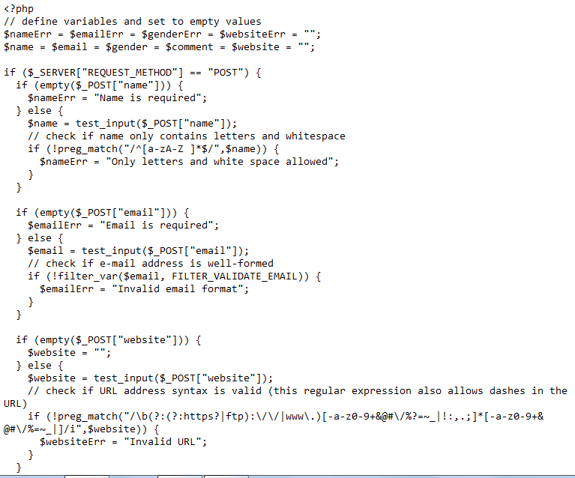

Slide 36
Name: <input type="text" name="name" value="<?php echo $name;?>"> E-mail: <input type="text" name="email" value="<?php echo $email;?>"> Website: <input type="text" name="website" value="<?php echo $website;?>"> Comment: <textarea name="comment" rows="5" cols="40"><?php echo $comment;?></textarea> Gender: <input type="radio" name="gender" <?php if (isset($gender) && $gender=="female") echo "checked";?> value="female">Female <input type="radio" name="gender" <?php if (isset($gender) && $gender=="male") echo "checked";?> value="male">Male

Slide 37
PHP Sessions

Slide 38
PHP Sessions
<?php
// Start the session
session_start();
?>
<!DOCTYPE html>
<html> <body>
<?php
// Set session variables
$_SESSION["favcolor"] = "green";
$_SESSION["favanimal"] = "cat";
echo "Session variables are set.";
?>
</body>
</html>

Slide 39
Cookies

Slide 40
Create Cookies With PHP
Syntax
setcookie(name, value, expire, path, domain, secure, httponly);

Slide 41
<?php $cookie_name = "user"; $cookie_value = "John Doe"; setcookie($cookie_name, $cookie_value, time() + (86400 * 30), "/"); // 86400 = 1 day ?> <html> <body> <?php if(!isset($_COOKIE[$cookie_name])) { echo "Cookie named '" . $cookie_name . "' is not set!"; } else { echo "Cookie '" . $cookie_name . "' is set!<br>"; echo "Value is: " . $_COOKIE[$cookie_name]; } ?> </body> </html>

Slide 42
Delete a Cookie
<?php // set the expiration date to one hour ago setcookie("user", "", time() - 3600); ?> <html> <body> <?php echo "Cookie 'user' is deleted."; ?> </body> </html>

Slide 43
Check if Cookies are Enabled
<?php
setcookie("test_cookie", "test", time() + 3600, '/');
?>
<html><body>
<?php
if(count($_COOKIE) > 0) {
echo "Cookies are enabled.";
} else {
echo "Cookies are disabled.";
}
?>
</body>
</html>

